Slide 1
DIGITAL PORTFOLIO
STUDENT NAME: R. SONA
REGISTER NO AND NMID: 41124134110500122021 , 12DCF678B20100B8D3649120BB0EA86A
DEPARTMENT: BCA ( Bachelor of computer Application)
COLLEGE: COLLEGE/ UNIVERSITY: Vivekananda College of
Arts and science for Women
( Annamalai University)

Slide 2
PROJECT TITLE
Student portfolio

Slide 3


AGENDA
Problem Statement
Project Overview
End Users
Tools and Technologies
Portfolio design and Layout
Features and Functionality
Results and Screenshots
Conclusion
Github Link
3/21/2024 Annual Review

Slide 4

PROBLEM STATEMENT
1. Lack of responsiveness: The website may not be fully responsive, as the CSS code doesn't include media queries to handle different screen sizes and devices.
2. Limited form validation: The contact form doesn't have any validation, which can lead to invalid or malicious input being submitted.
3. No error handling: The JavaScript code doesn't handle any potential errors that may occur when submitting the contact form.

Slide 5

PROJECT OVERVIEW
This is a basic student portfolio website with: 1. A navigation menu 2. An about section 3. A projects section 4. A contact form

Slide 6

WHO ARE THE END USERS?
End Users are: 1. Potential employers: Employers or recruiters who want to view a student's skills, projects, and experiences.
2. clients: Clients who want to hire a student for a project or collaboration.
3. Peers and mentors: Fellow students, teachers, or mentors who want to review and provide feedback on the student's work.

Slide 7

TOOLS AND TECHNIQUES
1. HTML: For structuring and organizing content. 2. CSS: For styling and layout. 3. JavaScript: For adding interactivity and dynamic behavior. 4. Responsive design: Using CSS media queries and flexible layouts to adapt to different screen sizes and devices. 5. DOM manipulation:Using JavaScript to interact with and modify the Document Object Model (DOM).

Slide 8
POTFOLIO DESIGN AND LAYOUT
The portfolio design and layout in the code include: 1. Simple and clean design:A minimalist approach with a focus on showcasing the student's work. 2. Navigation menu:A basic navigation menu for easy access to different sections. 3. About section:A brief introduction to the student. 4. Projects section:A showcase of the student's projects with images and descriptions. 5. Contact form:A simple contact form for visitors to get in touch.
8

Slide 9
FEATURES AND FUNCTIONALITY
Features 1. Navigation Menu: Allows users to navigate to different sections of the portfolio. 2. About Section: Provides a brief introduction to the student. 3. Projects Section: Showcases the student's projects with images and descriptions. 4. Contact Form:Enables visitors to send messages to the student. Functionality 1. Responsive Design: The layout adapts to different screen sizes and devices. 2. Interactive Contact Form:The contact form submits a message (with a placeholder alert). 3. Basic Styling:CSS is used to style the layout and make it visually appealing.

Slide 10
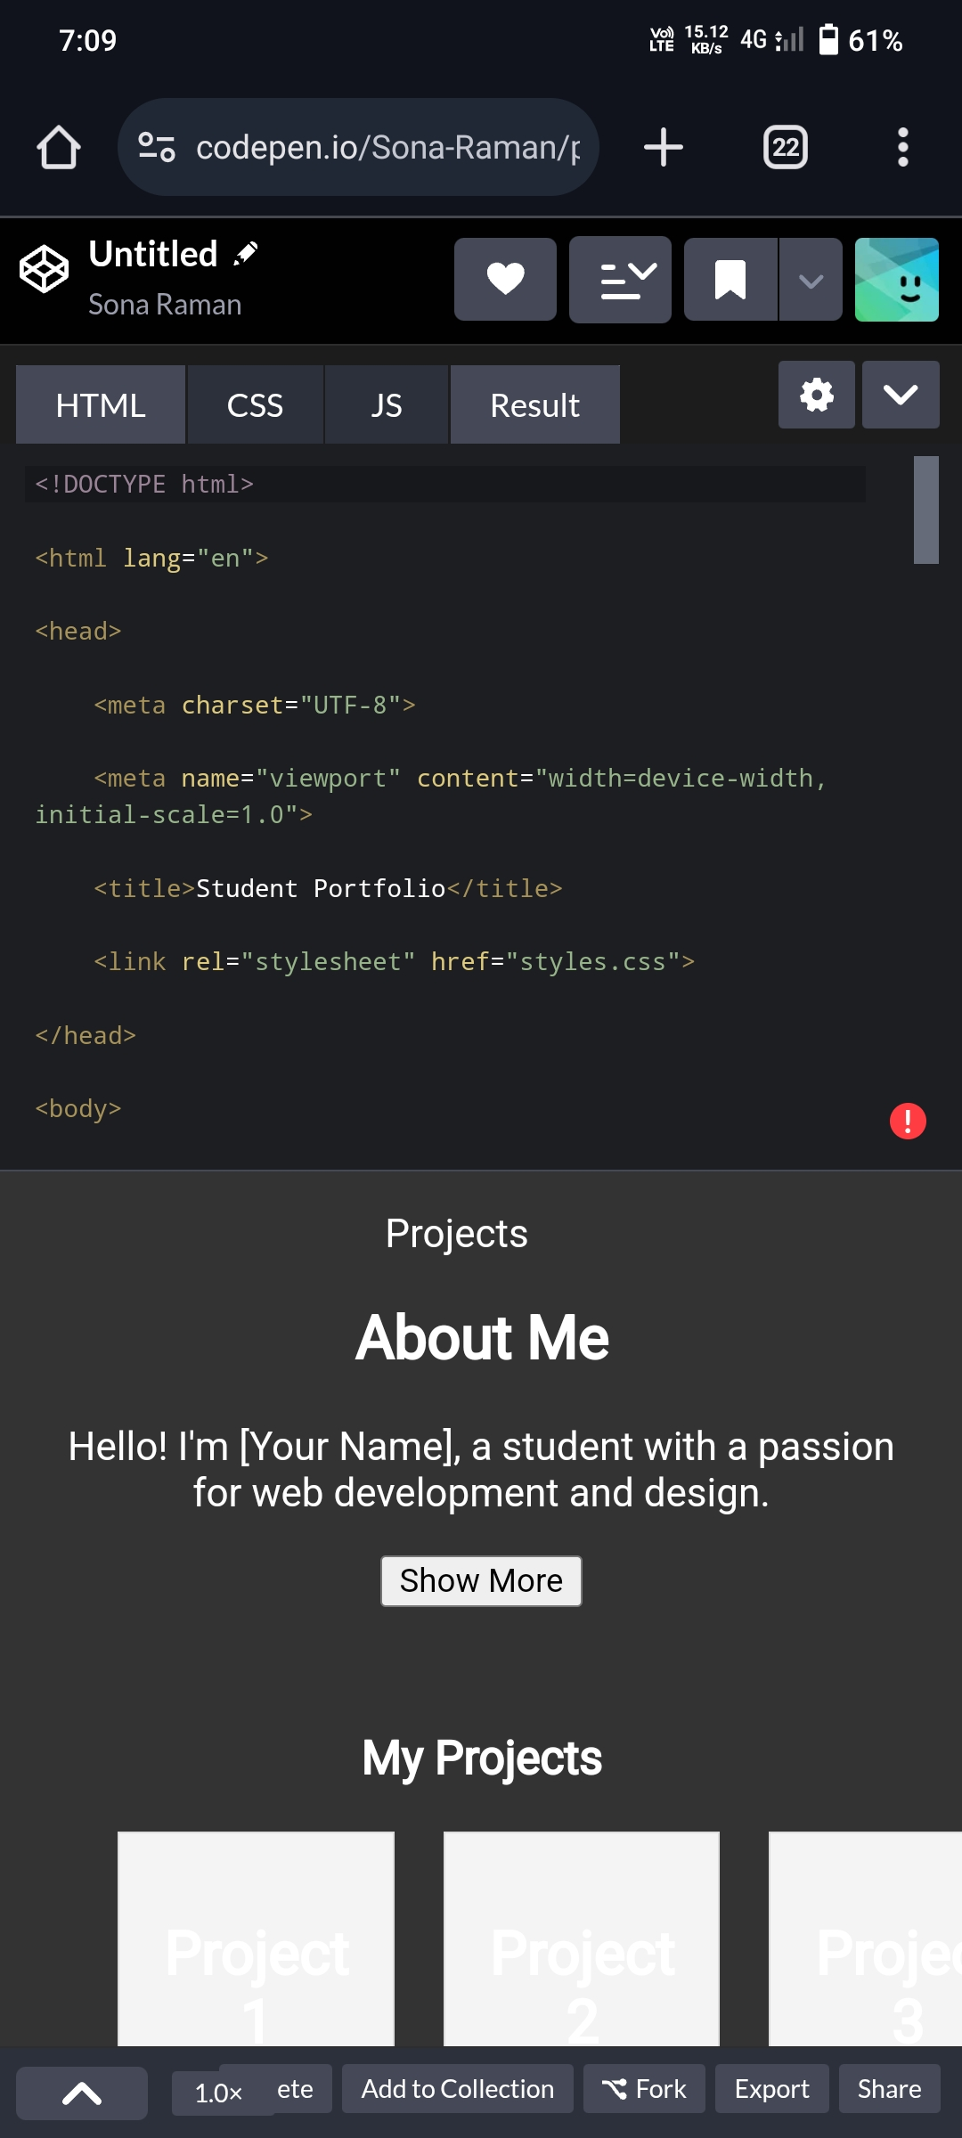
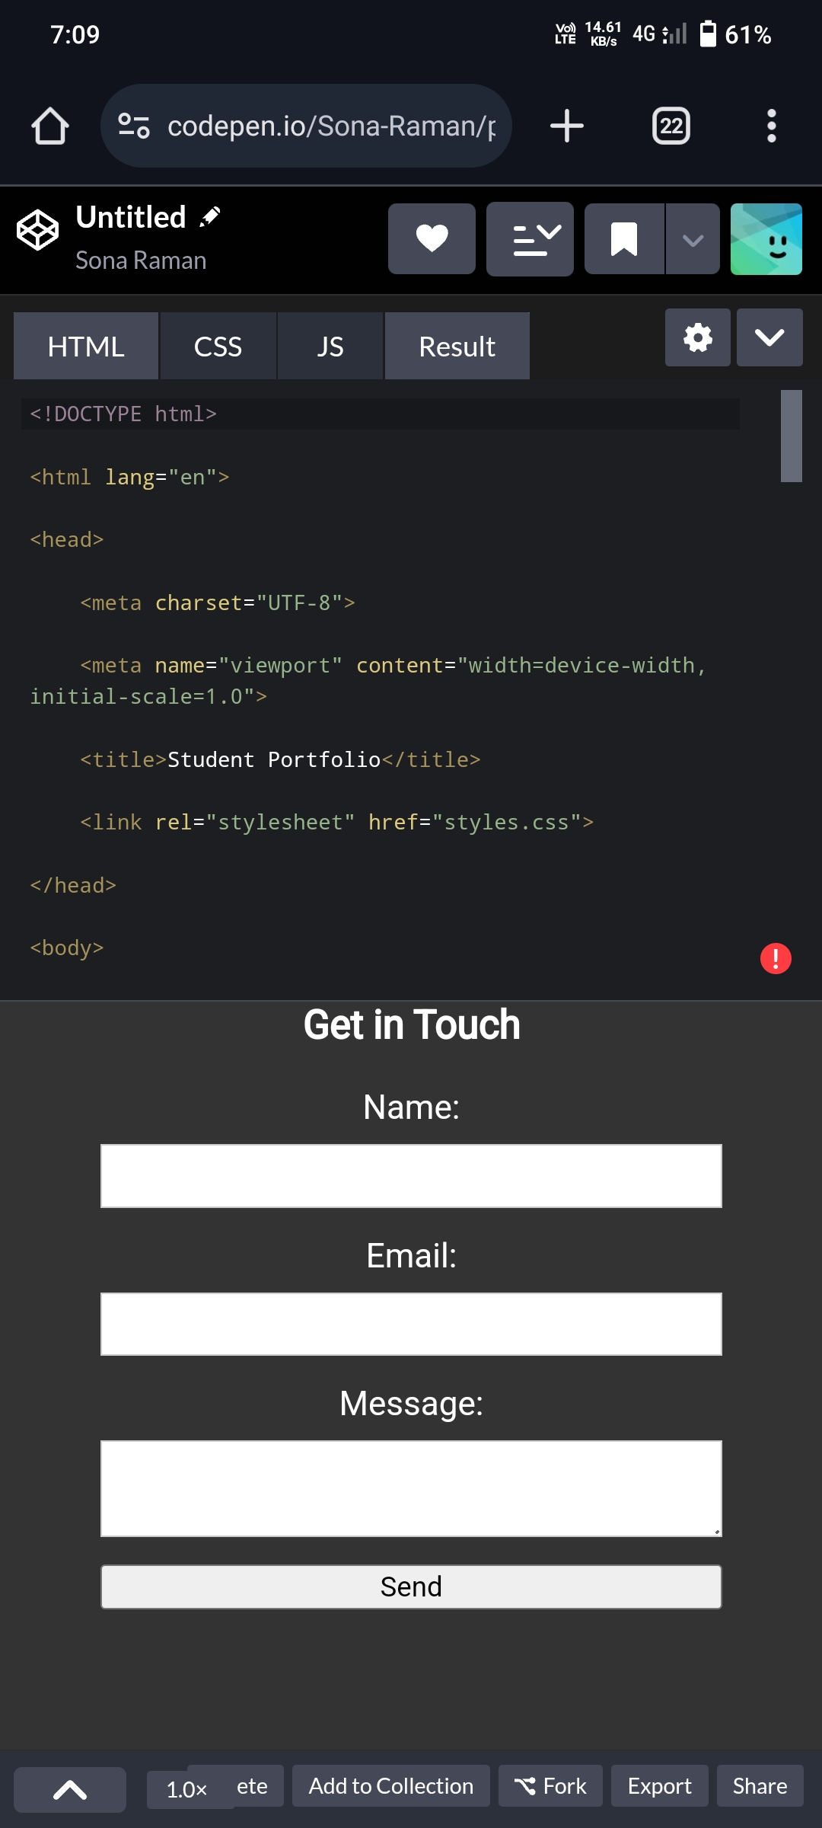

RESULTS AND SCREENSHOTS
3/21/2024 Annual Review
10

Slide 11
CONCLUSION
A student portfolio is an essential tool for showcasing skills, projects, and experiences, helping students stand out in academics and career pursuits. It demonstrates growth, creativity, and professionalism, making it a valuable asset for future opportunities.
https://github.com/sonaraman/Sona_raman.git
11

